Slide 1
Phenomenology and Existentialism
Western Worldview #1

Slide 2
Three Worldviews
After Skepticism did its worst, the Western intellectual scene responded in 3 basic ways:
Existentialism
Naturalism
Theism
Some existentialists are theists, some naturalists are theists, but, generally, skepticism lead thinkers to not just epistemological positions, but to full-scale worldview commitments.

Slide 3
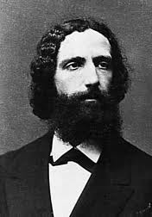
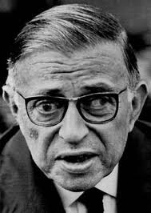
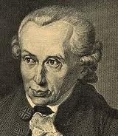
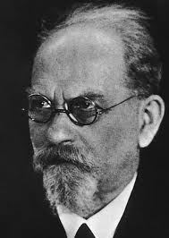
Germany
France
Brentano (1838-1917)
Sartre (1905-1980)
1800
2000
Germany
Germany
Kant (1724-1804)
Phenomenology to Existentialism
Husserl (1859-1938)

Slide 4
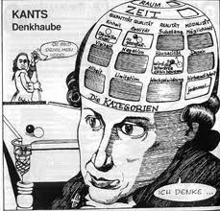
Kant, Brentano, Husserl
Kant was awoken from his “dogmatic slumbers” by Hume.
His response was The Critique of Pure Reason.
There, transcendental arguments (x is a necessary condition for the possibility of y, therefore, since y, x) prove the reality of a self, causation, and external reality.
Kant divides reality, then, into …
Phenomena
Noumena
One way to think of the distinction: the phenomenal world is the world of experience; the noumenal world we can know almost nothing about because none of our concepts apply to it. All we can know of it is that it exists.
Read about Kant and this ‘two worlds’ view here

Slide 5
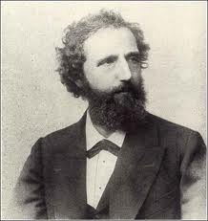
Kant, Brentano, Husserl
Brentano notices, in paying close attention to phenomena, ‘consciousness’ is always ‘consciousness of’ something. There is no such thing as consciousness by itself, without an object it is of.
Brentano calls this feature of consciousness ‘intentionality’.
His work is credited with helping distinguish psychology as an independent science (he played a role in establishing the first experimental psychology laboratories in Europe), but his own studies were from a first-person perspective (like Descartes): studying direct experience, phenomenologically.
Read about Brentano
Franz Brentano (1838-1917)

Slide 6
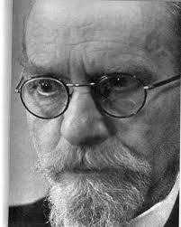
Kant, Brentano, Husserl
Husserl is the father of Phenomenology.
Impressed with the limitations of skepticism, he suggests the only way for philosophy to be a rigorous science is by ‘bracketing’ experience from commitments to “natural attitude.”
Natural attitude is, roughly, common sense realism about the world.
His method is to eschew explanation or theory in favor of pure description of direct or first-person experience.
Such a method is called ‘phenomenological reduction’.
Read about Husserl here
Edmund Husserl (1859-1938)

Slide 7
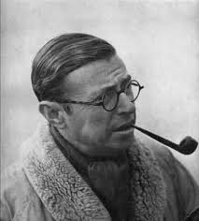
Sartre and Existentialism
Sartre is the father of Existentialism.
In Being and Nothingness, he presents his views about “human reality” based on his phenomenological studies.
He rejects the notion of human nature, arguing that, for humans, “existence precedes essence.”
How is that so?
Well, let’s look …
Jean-Paul Sartre (1905-1980)
Internet Encyclopedia of Philosophy for Sartre and Existentialism

Slide 8
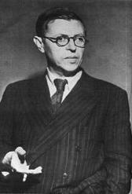
Sartre and Existentialism
Being and Nothingness:
Being-in-itself (en-soi), is pure being, all we are or can be conscious of.
Being-for-itself (pour-soi), is consciousness. Consciousness is always consciousness of something, as Brentano had said. Primarily, that something is being-in-itself. Consciousness is, though, also aware of itself (of itself being/existing), to that extent a being, but aware, so also not a being. (yes, it is contradictory)
So human reality is divided between consciousness (pour-soi) and its objects (en-soi) … between nothingness and being.

Slide 9
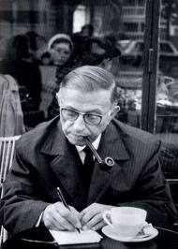
Sartre and Existentialism
So, on the level of pure description, Sartre offers these observations about human reality:
The for-itself, or consciousness, desires being. But, being “shot all through with nothingness,” cannot be . For Sartre, “man is a useless passion.”*
Consciousness is the source of negation or non-being in the world, while still being a being. Some metaphors and illustrations may help …
*See Paul Spade, p.126

Slide 10
Metaphors for Consciousness
Paraphrasing, Sartre calls consciousness ‘a wind blowing toward objects’, and says it is ‘coiled in the heart of being like a worm’.
Consider these illustrations to help form a concept of consciousness:

Slide 11
Illustrations of Consciousness
When the reflection departs, then the reflecting glass, we’re left with bare awareness of the object represented by the arrow. The arrow indicates the directionality of consciousness … just remember consciousness isn’t the arrow either.

Slide 12
Illustrations of Consciousness
You can think of consciousness (the dotted line) as a ‘leaning away from being’ … as there is always some distance between consciousness and its objects.*
Then, of course, remove the line, remembering that consciousness is “shot all through with nothingness,” as any being that is the source of negation must be.
*See Paul Spade, p.130

Slide 13
The Source of Objects
As being-in-itself is pure positivity, pure being, the negating acts of consciousness determine what we perceive.
Negate the black portion and you get ____?
Negate the white portion and you get ____?
Where does (could) negation come from?
Only from a being that is a nothingness.
Two Faces and a Vase

Slide 14
Interesting Consequences
With the fundamentals in place, let’s look at a few insights available about “human reality”…
“Hell is other people.”
As being-for-itself desires being, it finds its best hope for being in objectification by others. The trouble is, others may refuse, involving you in objectifying them, reducing your sense of identity.
It is also possible for the for-itself to desire freedom, and, annoyingly, others may react by objectifying you when you don’t desire it. Also, others often objectify you in ways they want, not in ways you want.

Slide 15
Hell is Other People Examples
List some movies, experiences, stories where characters make other’s lives hell by conceptualizing them in hostile ways:
______________________________
______________________________
______________________________
______________________________
______________________________

Slide 16
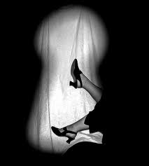
Existence of Others
Sartre offers something of a proof of the existence of others in much the way Kant tries to prove the existence of the self.
In a Being and Nothingness chapter called “The Look,” he argues that the phenomenon of shame is possible only when our for-itself is an object of another consciousness.
See Paul Spade, p.211

Slide 17
Self-Consciousness
Β
A. Non-positional consciousness:
Consciousness is pure interiority, yet being transparent to itself, is always consciously conscious.
B. Positional consciousness:
Consciousness can be conscious of itself as an object: self-consciousness. Self-consciousness arises only after being observed by another (the Look). It is an unnatural conscious act to become self-conscious. Self-consciousness is a sickness.
Α

Slide 18
More Consequences: Radical Freedom
An enormous theme in Existentialism is the role of radical freedom. Perhaps because of its non-being, consciousness is radically free (at least it is experienced as such).
Have you ever looked over the railing on a bridge and realized you could jump? Did it frighten you? If it did, you were, that moment, aware of your radical freedom.

Slide 19
Masochism and Sadism
Hell isn’t always other people. Sometimes others are a sort of salvation:
If your experience of radical freedom is intense or vivid, you will feel the need to think of yourself as an object.
Objects are definite, inert things.
Objects lack freedom.
Objects are safe.
If you want to feel that safety, tone down that unnerving sense of freedom, gain that sense of identity, you will need someone willing to objectify you.

Slide 20
Masochism and Sadism
Hell isn’t always other people. Sometimes others are a sort of salvation:
If your identity is onerous, you assert your subjectivity by objectifying others and turning back their gaze.
Subjects are indefinite, active wills.
Subjects are free.
Subjects are unpredictable.
If you want to feel that unpredictability, gain that sense of freedom, quash that sense of identity or objectness, you will need someone willing to submit to you.

Slide 21
Nausea
Being radically free leaves the for-itself radically responsible for its choices.
Nausea arises when we realize the enormity of our moral responsibility.
Nausea arises when we notice our freedom to control how we see things, others, our lives generally … a main theme in the novel.

Slide 22
Bad Faith
Bad Faith is a condition in which we conceal the truth from ourselves (something possible only for a contradictory being … since concealing a truth requires that we know what to hide).
Sartre’s example is a homosexual pederast. The man believes he only has sex with boys occasionally, and from curiosity, playfulness, etc. He exhibits bad faith.
On the other hand, Sartre considers the champion of sincerity who wants him to admit his homosexual pederasty. The sincere man also exhibits bad faith, since human reality does not admit of identity. No one can be a homosexual pederast … except in the sense that they can exhibit a pattern of conduct.
Read an excerpt about Bad Faith
Any time we identify with our role playing, we exhibit bad faith.
When we consider ourselves only role players, we exhibit bad faith.

Slide 23
Does the Mind Know an External World?
According to Sartre, the mind is an object for consciousness, but we can, still, ask about knowledge: our knowledge extends this far:
Of our own existence: no knowledge (slide 17) … the Ego arises only after self-consciousness, and as mere creation of consciousness (it does not attend all our experience, as Kant said, but merely can attend all experience)
Of God’s existence: negative knowledge … God would be a for-itself, in-itself … a being-for-itself grounding its own existence … something impossible
Of other selves and physical things (other minds and external objects): other selves, as other consciousnesses, we know through shame. Of physical things, external objects, we can know they exist because as nothingness, consciousness must be supported by something (slide 12)

Slide 24
References
All philosopher photos from Google Images. Search on philosopher’s name.
Two Faces and a Vase, Masochism photo, Sadism Kitty, and Career art images also from Google Images.
No Exit book cover:
http://en.wikipedia.org/wiki/No_Exit
Nausea book cover:
http://en.wikipedia.org/wiki/Nausea_%28novel%29

